Slide 1
Search
“How do I find a solution to a problem?”

Slide 2
The problem
Give some description of a goal, how to achieve it?
Think of agent
Being in some state
Chess: board position
Knowing what properties a goal state should have
Chess: king in check, nowhere to move that isn’t in check
Knowing how to move from state to state
Chess: rules of the game
State space: composed of all possible states
State space search:
From a start state, find a path to a goal state

Slide 3
What can be represented in this formalism?
Anything that has objects, properties, relationships , ways to get from state to state
Chess: board, pieces, properties of pieces, locations of pieces, moves…
Theorem proving: axioms, rules of inference, theorem, objects
Route planning: locations, roads, direction of travel of roads, speed limits, …

Slide 4
What can be represented in this formalism?
Mobile robot: robots, other objects, locations, locations of objects, actions robot can take, sensor data, …
Medicine: patient, providers, equipment, pathogens, drugs, drug—patient effects, drug—pathogen effects, …
Natural language understanding: words, phrases, definitions, grammar rules,…

Slide 5
Domains
Domain: the world of the agent
Domain knowledge: what agent can know about world
Chess: moves, pieces’ worth, …
Mobile robot: actions, action results, sensors, temperature, objects can’t occupy same space, …
Medicine: anatomy, physiology, pathology, pharmacology, …
Agent may know domain knowledge, or could be built in to problem/solution formalization

Slide 6
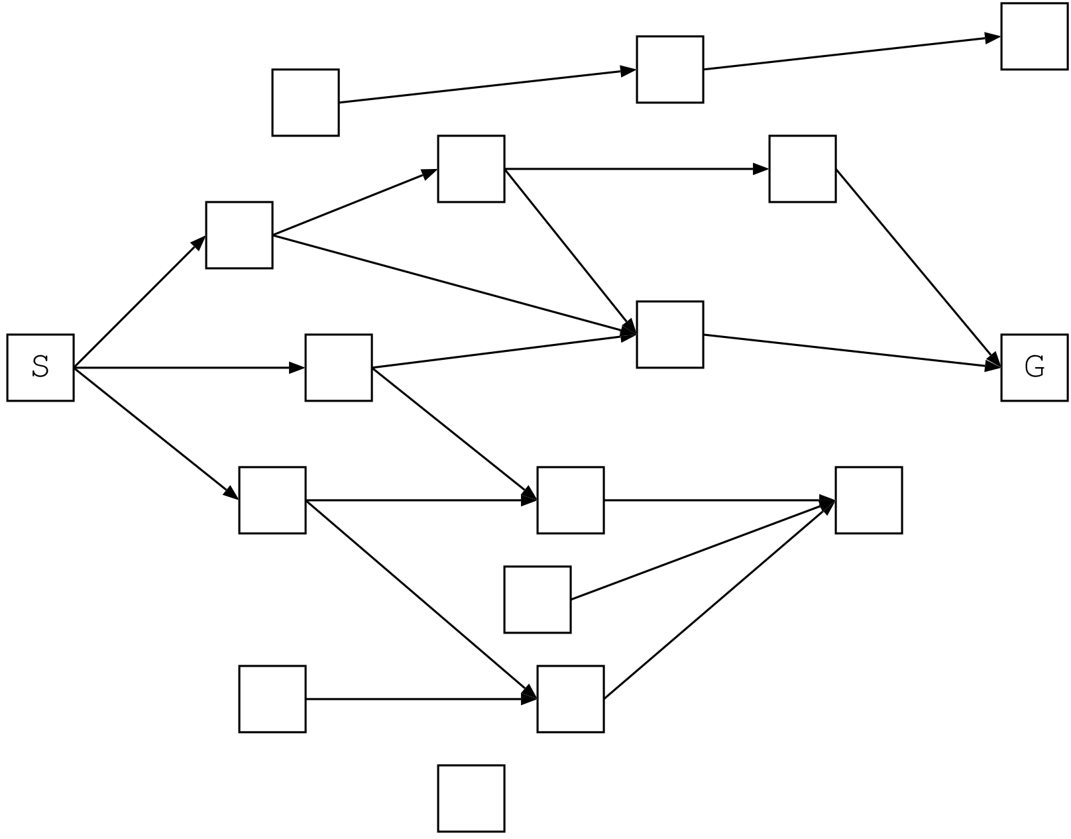
State spaces
Model state space with graph
Often a digraph — e.g., one-way streets, irreversible reactions, …

Slide 7
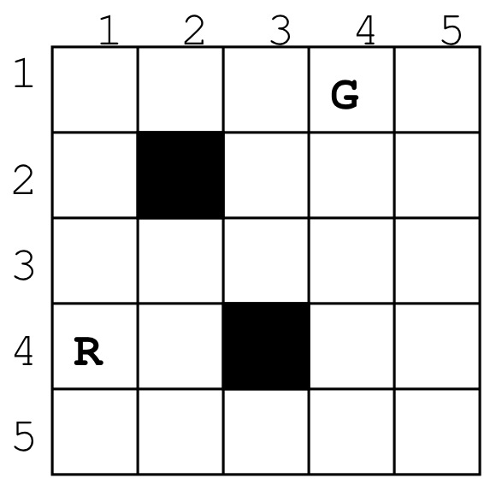
State spaces
R
R
R
R
R
R

Slide 8
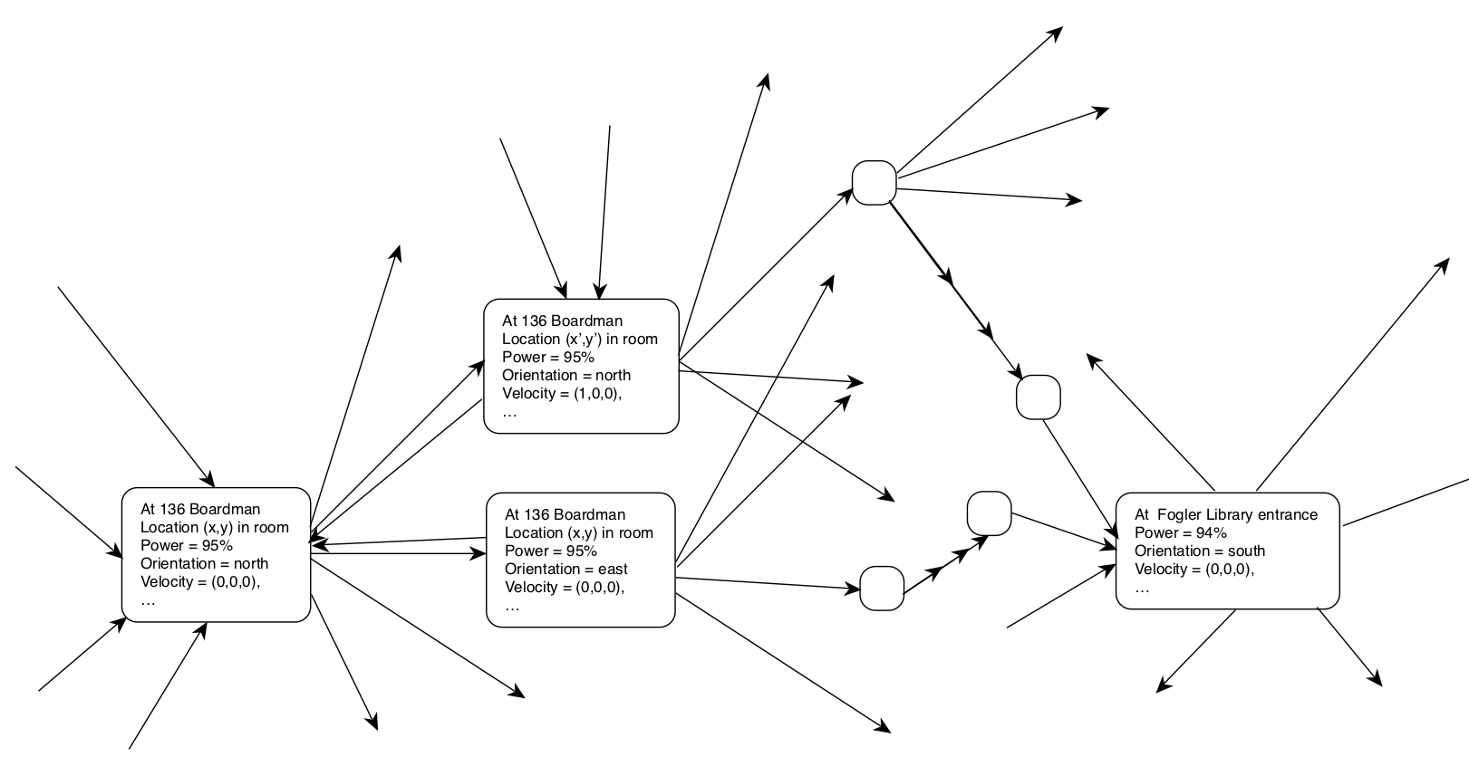
State spaces

Slide 9
State space search formalism
Problem: state space + start state + goal state description
Description may completely or partially describe goal
May have 0, 1, or more actual goal states
Solution: path from start state to goal state
Search: process of finding the path
Start at start state
Expand the start state by finding its children (neighbors)
If goal found, stop
Else, systematically expand children, etc.

Slide 10
State representation issues
What to put in the state?
Important stuff
Enough to differentiate between states
What to leave out?
The rest
Saves space, time during matching

Slide 11
State representation issues
Represent entire state?
Partial state representation?
Concentrate search on important features of goal
Can match multiple goals
Concrete or abstract state description?
“White king is on K1, black queen is on Q1,…” or “White king is in check, no moves that aren’t also in check”
Other abstract representations: “understand the utterance”, “diagnose the patient’s problem”, “create a plan to build a house”, …
Relative or absolute description (of goals, esp.)?
“Closest state to the ocean”
Diagnosis that covers most symptoms

Slide 12
State space representation
Represent entire state space?
Pros: can use global knowledge, can guarantee optimal path
Cons: map of space may be unavailable, size may be huge (GPS route planning, chess) or infinite (NLP) — too big to store, too big to search efficiently
Generate states as needed?
Need operators to apply to states ⇒ children
Pros: cheaper for large search spaces, can deal with huge/infinite search spaces
Cons: maybe inefficient for small search spaces, may not be able to “run” operators in reverse

Slide 13
Operators
Operator — if s, si are states:
Operator set: defines all legal state transitions
Choosing operator to apply to state:
Match description of applicable state(s) to current state
Preconditions
Operator provides description of new state
$$f(s)→\{s_{1},s_{2},…\}$$

Slide 14
Robot world:
State representation?
Initial state? Goal state?
Operators?

Slide 15
Uninformed search

Slide 16
Blind (uninformed) search
Basically, all the searches you’ve seen so far
No information used about topology of state space
Which node chosen for expansion ⇒ search type

Slide 17
Search trees
Search space: graph of states
Search tree:
Record/state of search so far
Root: node corresponding to initial state
Leaves: nodes that are candidates for expansion (frontier)
Interior nodes: states that have been seen/expanded
Nodes ⇔ states
Information about the state
Bookkeeping information
Don’t want repeated nodes
Path from root → goal node at leaves = solution

Slide 18
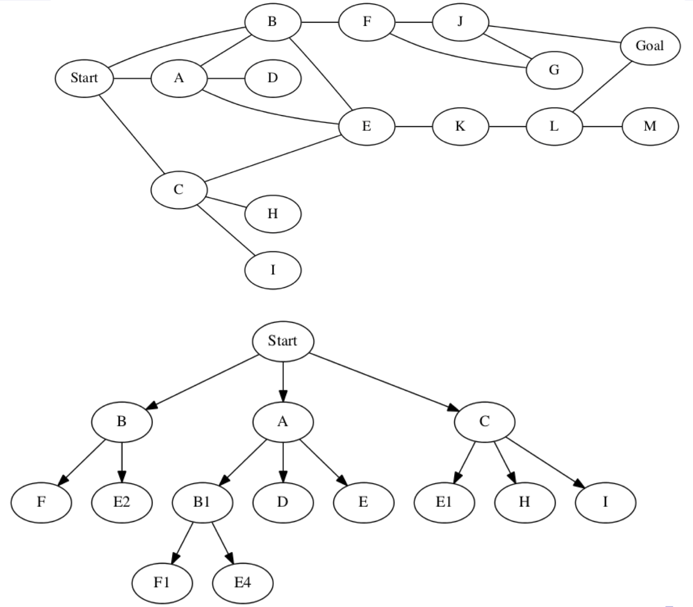
Search space vs search tree

Slide 19
Kinds of search algorithms
Uninformed search
No knowledge about search space guides search
Often exponential in worst & average case
Not exponential in total number of nodes n!
Rather, search is exponential in depth of search tree
If b = branching factor, d = depth, then most are
n is also
Informed (heuristic) search
Use heuristic knowledge to choose nodes
Heuristics about topology, problem structure, domain, problem solving itself
$$O(b^{d})$$
$$O(b^{d})$$

Slide 20
Kinds of search algorithms
Searches also differ by general order they expand nodes
Breadth-first search (BFS)
What is it?
Implement with what data structure?
Depth-first search (DFS)
What is it?
Implement with what data structure?
Temporal backtracking
Backtracking during search vs during execution

Slide 21
Evaluating search algorithms
Completeness
Time/space complexity
Optimality
of quality of solution (path cost, goal selected)
of search effort/space
Complexity of algorithm (to some extent)
Surprise: trade-offs!

Slide 22
Evaluation of BFS
As a group, answer:
Complete?
Optimal? If yes, under what condition(s)?
Time complexity?
Space complexity?

Slide 23
Evaluation of BFS
Complete?
Optimal? If yes, under what condition(s)?
Time complexity:
Process each node, each edge, so
Best, average, and worst-case time!
Cool — linear…right?
Suppose goal is d links away from root, and on average branching factor is b
#nodes seen/expanded? or, better, what is | E |?
Space complexity?
$$O(|V|+|E|)$$
$$O(b^{d})$$
$$O(b^{d})$$

Slide 24
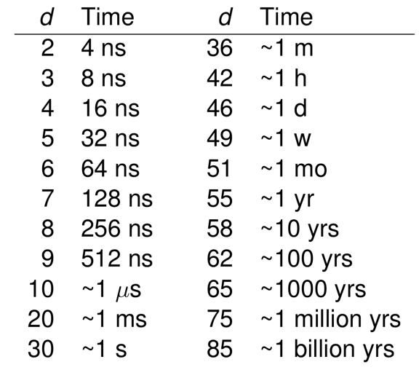
How bad is that, though, really?
Suppose b = 2, process 1 edge/ns

Slide 25
How bad is space complexity?
Do we need to store all expanded nodes?
Could prune branch when we reach known node
Problem: how do we know?
Worst case — search space is a tree
Suppose only require 1 byte/node
For b, d from before:
Goal at level 30 ⇒ need 1 GiB
Goal at level 85 ⇒ 32 YiB (yobibytes or 39 yottabytes) = 35 trillion TiB!
If d = 266, store 1 bit/atom, would need all the atoms in the universe

Slide 26
Evaluation of DFS
As a group, answer:
Complete?
Optimal? If yes, under what condition(s)?
Time complexity?
Space complexity?

Slide 27
Evaluating DFS
Complete?
Optimal? If so, under what condition(s)?
Time & space complexity?
With branching factor b and goal depth d…
What’s max #edges traversed in worst case?
What’s the max # nodes stored at any one time?
All of them!
$$O(bd)$$

Slide 28
BFS vs DFS
 | BFS | DFS
Complete? | Yes | Yes
Optimal? | Yes (with uniform costs) | No
Time? | Exponential | Exponential
Space? | Exponential (b=2,d=80: ~1E12 TiB) | Linear (b=2, d=80: 2x80=160 B)
Other | Susceptible to infinite b | Susceptible to infinite d

Slide 29
Can we do better?
Iterative deepening DFS (IDFS)
Use DFS to search a series of depths into the graph
Overall, behaves like BFS: expands level at a time

Slide 30
Can we do better?
Iterative deepening DFS (IDFS)
Use DFS to search a series of depths into the graph
Overall, behaves like BFS: expands level at a time
Properties:
Complete?
Optimal?
Time complexity?
Space complexity?

Slide 31
Finding optimal paths
With uniform costs: BFS works
But what about weighted graphs?
Maybe apply idea of BFS to weight maxima rather than edges
Branch-and-bound search
Keep track of a frontier of unexpanded nodes
Keep track of cost of path to each node
Expand cheapest node among all nodes on the frontier
Stop when cost of path to goal < or = to cost to all other nodes on frontier
Also called, confusingly enough, uniform cost search

Slide 32
Branch-and-bound search

Slide 33
Branch-and-bound search
Complete?
Optimal? If so, under what condition(s)?
Non-negative cost edges/operators
Test for goal prior to expansion
Time complexity?
In worst case: expand everything: exponential w/ b, d
But may not have to expand all nodes at goal depth
If not, then effective branching factor < b
If 𝜖 = min step (link) cost, C = cost of best path:
$$O(b^{C/ϵ})$$

Slide 34
What about Dijkstra’s algorithm?
Dijkstra’s [1959] finds shortest path to all nodes from start node
Can be modified to stop when a goal is found
Running time
So why not use it?
Well, we are, sort of — branch-and-bound is variant that stops when goal is found
Complexity roughly the same:
$$O(|E|+|V|log(|V|))$$
$$b^{d}≤|E|$$

Slide 35
Bi-directional search
Should mention: can search backward from goal → start
Why would you?
Could try searching both ways
If searches meet, then done
Two searches of depth d/2
Time complexity
Problems:
Can’t use partial goal descriptions
Hard to deal with multiple goal states
Have to be able to regress through operators when going backward
$$O(b^{d/2})$$

Slide 36
Kinds of problems and search

Slide 37
Properties of problems
Problems differ by their characteristics
Different problems ⇒ different difficulty, different search techniques

Slide 38
Kinds of problems
Synthesis vs classification
Classification (categorization)
“What is category does this thing belong to?”
Ex: image recognition, NLP, diagnosis, loan decisions
Also called analysis problems
Synthesis
“How do I create x?”
Ex: automated planning, scheduling, design
Also called construction problems
Can have elements of both

Slide 39
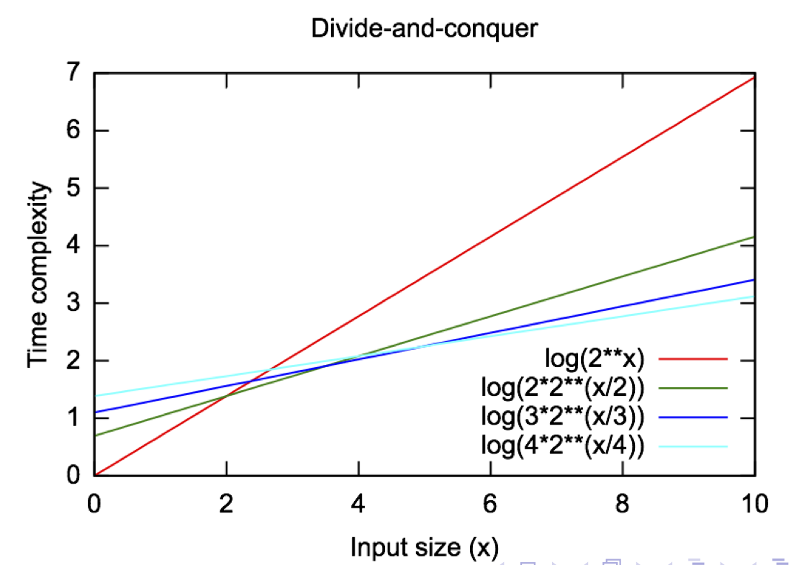
Kinds of problems
Decomposable or not?
Can problem be decomposed into independent subproblems?
If so, maybe amenable to divide-and-conquer techniques
Suppose solving problem is as are the subproblems
Break into m pieces
Time is now
Some problems:
nearly-decomposable
$$O(2^{n})$$
$$O(m2^{n/m})$$

Slide 40
Kinds of problems
Problems can vary based on step characteristics:
Steps are ignorable?
Steps are reversible?
Steps are recoverable?
Steps are irrecoverable?

Slide 41
Kinds of problems
Problems can vary by domain predictability
Predictability of world, agent’s own actions
Unpredictability ⇐ uncertainty in knowledge, uncertainty in percept, lack of knowledge, stochastic nature of world
Frame problem
Effect on solution: suboptimal solutions, no/wrong solution, increased time/space complexity
Predictable domains ⇒ easier to solve, planning is more useful
Toy domains: 8-puzzle, water jug problem,…
Games: TTT, chess, …
Real world

Slide 42
Kinds of problems
Problems vary by kind of solution needed
Absolute solution: find a solution or not
Optimization problems
Find cheapest, shortest, etc. solution
Almost always much harder than just finding solution — often NP-hard
Optimize over:
Result: find best of all goal states, find best of all paths to goal state
Solution itself: take least amount of time/effort to find solution

Slide 43
Kinds of problems
Based on role of knowledge:
to generate states
to recognize solution
to constrain search
Ex:
Find any path to goal in graph: no knowledge needed
Find best path to goal in graph: knowledge of weights, heuristics to predict future weights, etc.
Planning, robot control: moderate amount of knowledge
NLP, medical diagnosis: large amount of knowledge

Slide 44
Kinds of problems
Whether or not other agents are present
Multiagent systems, human user, etc.
Other agents may
be source of uncertainty
may actively undo/hinder your work

Slide 45
Kinds of problems
Single vs multi-state problems
State → state
{state, state,…} → {state, state,…}
Due to uncertainty, ⇒ harder problem
Could build contingencies into solution, or interleave action & search
Exploration problem — worst of the worst

Slide 46
Search and agents

Slide 47
Where does search fit into an agent?
Could be used by agent program (e.g., to find a route)
Could be the agent program:
Find best next state, return action to get there
Find complete path, return next action each time called

Slide 48
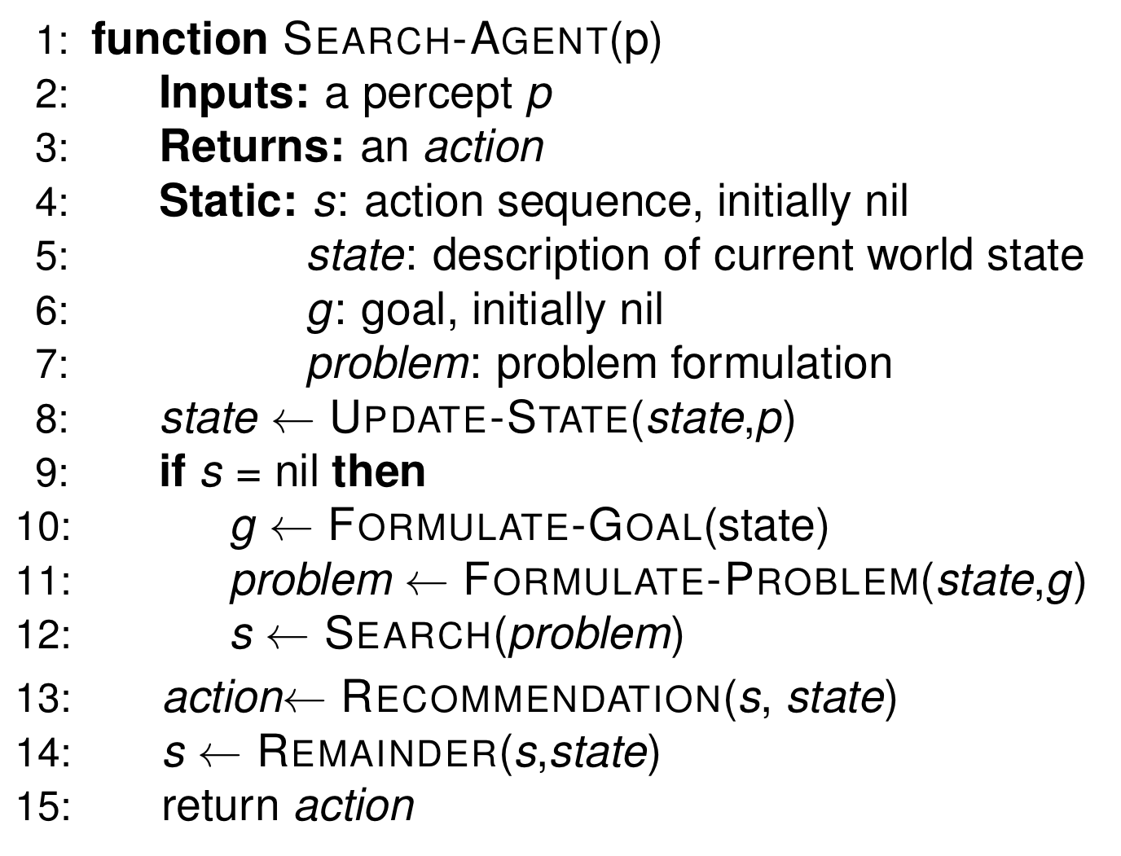
Generic search-based agent

Slide 49
Reflex agents and search
One view: no search at all
Another: a purely local search
Find next best state, return it
E.g., Roomba, possibly ants,…
Pure reflex agents: only current percept
Model-based reflex agents: percept + memory
Search occurs in the world itself

Slide 50
Goal-based agents
Use search to find how to achieve goals
Search usually:
> local
“thinks” about the search — not search in real world

Slide 51
Utility-based agents
Search to find best way to achieve goal
Optimizers
May want optimal solution and/or optimal search
Also “think” about search rather than search in world

Slide 52
Learning agents
Perform meta-level search
Start state: current performance module’s knowledge
Goal state: performance module’s knowledge that can best achieve agent’s goals
Transitions: tweaks to knowledge
E.g., reinforcement learner — adjust state ↔︎ expected reward function (Q-learning)
E.g., neural networks — adjust weights between nodes down a gradient in an error function

